Slide 1
Previously on
Mechatronic equipment
Mechatronic equipment

Slide 2
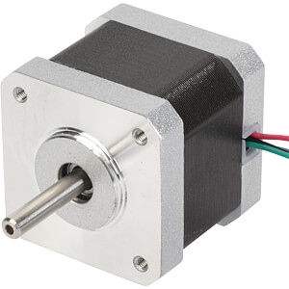
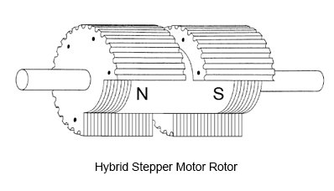
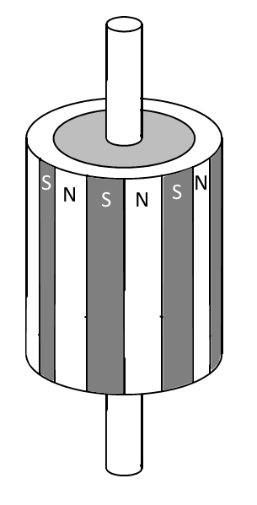
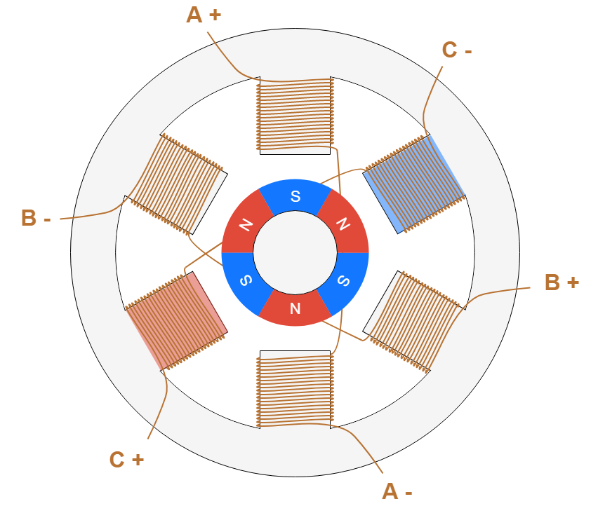
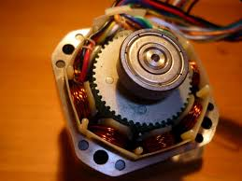
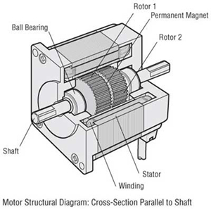
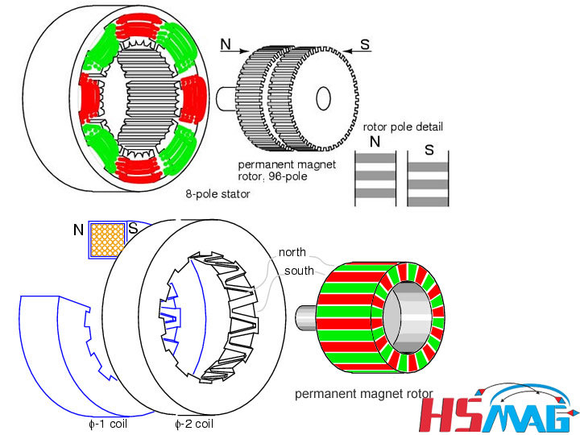
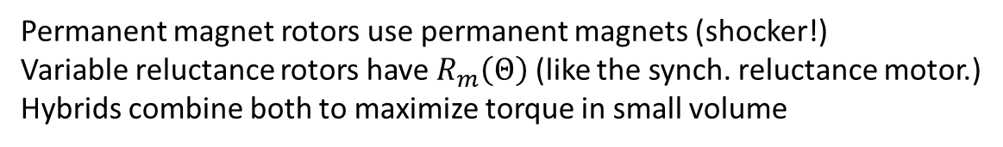
What’s a stepper motor?
Permanent magnet rotors use permanent magnets (shocker!)
Variable reluctance rotors have $R_{m}\left(Θ\right)$ (like the synch. reluctance motor.)
Hybrids combine both to maximize torque in small volume
Variable reluctance rotor
Permanent magnet

Slide 3
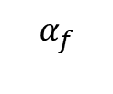
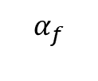
Stepped magnetic field
$$α_{f}$$
$$α_{f}$$
t
t
Field angle of a rotating field
Field angle of a stepped field

Slide 4
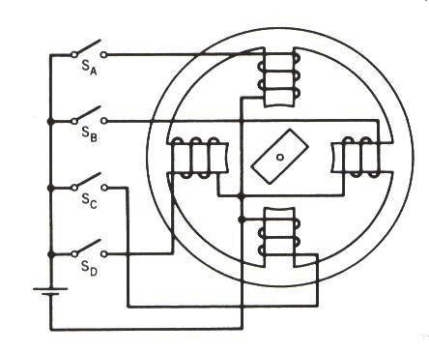
Full step mode
Same step size can be achieved using different coil commutation that results in different MMF. Same number of coils are active each step.
1
F
3
F
2
F
4
F

Slide 5
Half step
F
F
F
1
F
2
3
4

Slide 6
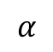
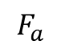
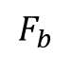
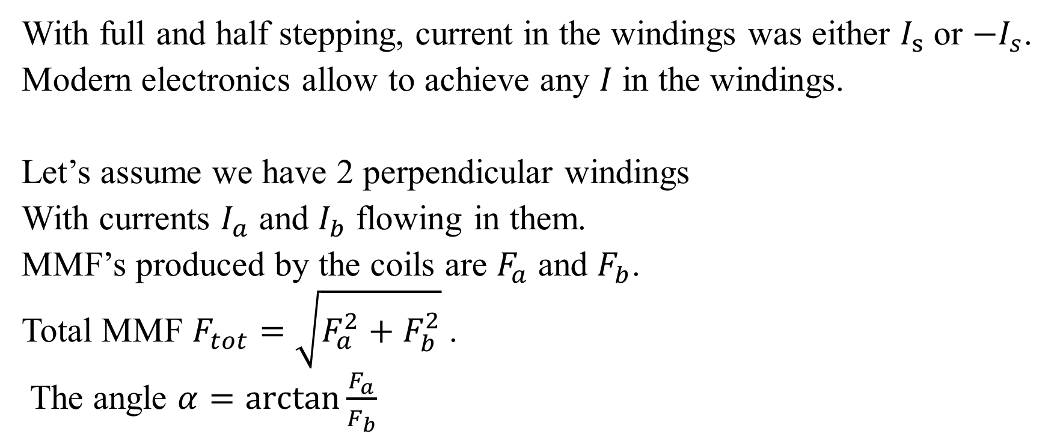
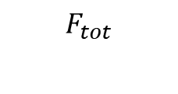
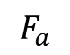
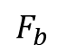
Microstepping
With full and half stepping, current in the windings was either $I_{s}$ or $−I_{s}$.
Modern electronics allow to achieve any $I$ in the windings.
Let’s assume we have 2 perpendicular windings
With currents $I_{a}$ and $I_{b}$ flowing in them.
MMF’s produced by the coils are $F_{a}$ and $F_{b}$.
Total MMF $F_{tot}=\sqrt{F_{a}^{2}+F_{b}^{2}}$.
The angle $α=\arctan{\frac{F_{a}}{F_{b}}}$
$$F_{a}$$
A
B
$$F_{b}$$
$$F_{tot}$$
$$F_{a}$$
$$α$$
$$F_{b}$$

Slide 7
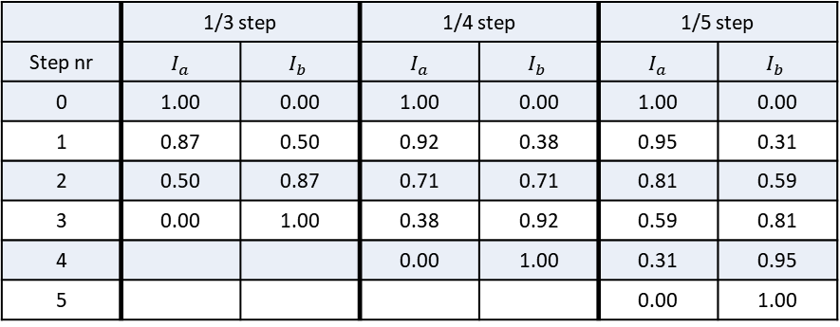
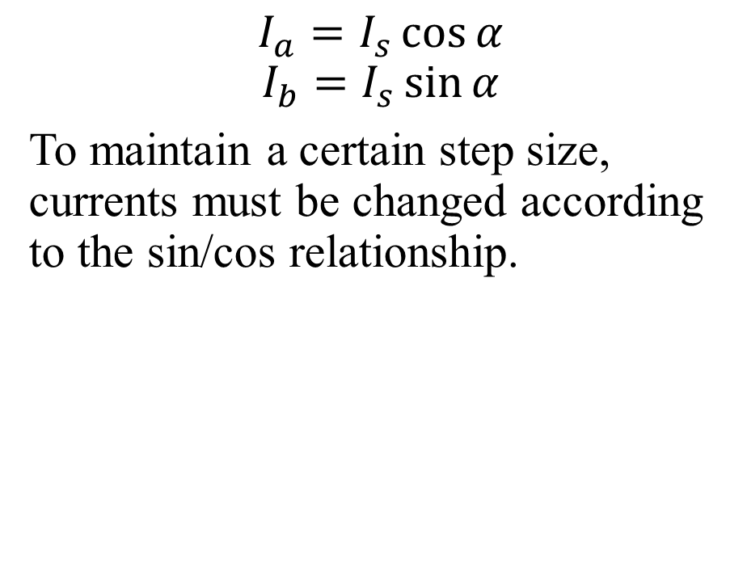
Microstepping
$$I_{a}=I_{s}\cos{α}$$
$$I_{b}=I_{s}\sin{α}$$
To maintain a certain step size, currents must be changed according to the sin/cos relationship.
 | 1/3 step |  | 1/4 step |  | 1/5 step
Step nr | $I_{a}$ | $$I_{b}$$ | $I_{a}$ | $$I_{b}$$ | $I_{a}$ | $$I_{b}$$
0 | 1.00 | 0.00 | 1.00 | 0.00 | 1.00 | 0.00
1 | 0.87 | 0.50 | 0.92 | 0.38 | 0.95 | 0.31
2 | 0.50 | 0.87 | 0.71 | 0.71 | 0.81 | 0.59
3 | 0.00 | 1.00 | 0.38 | 0.92 | 0.59 | 0.81
4 |  |  | 0.00 | 1.00 | 0.31 | 0.95
5 |  |  |  |  | 0.00 | 1.00

Slide 8
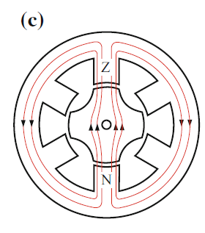
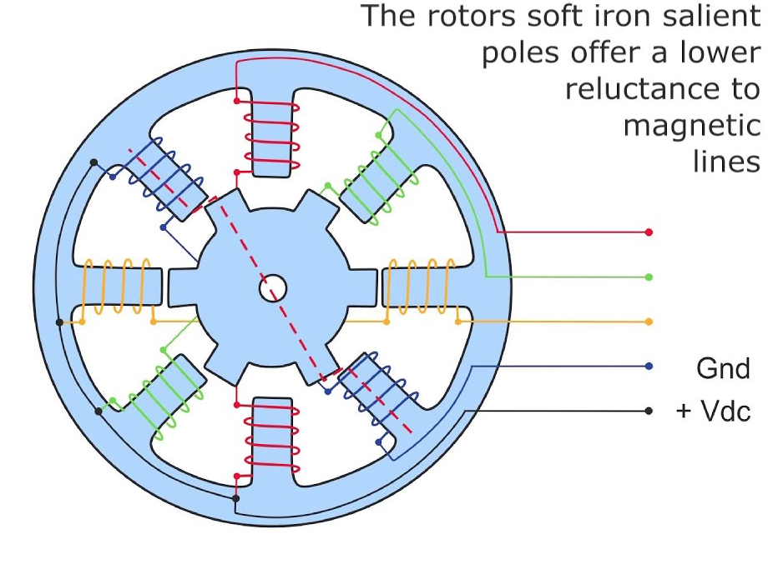
Reluctance stepper motors: basics
Reluctance motors are synchronous motors that do not have coils or magnets in their rotor. Rotor is comprised such that magnetic resistance would vary with rotation angle. In steppers, this is realized this by including teeth into rotor. Teeth represent path of lowest reluctance and the gaps- highest. This makes the rotor of salient type.
Highest reluctance
Lowest Reluctance
Lowest Reluctance
Highest reluctancex

Slide 9
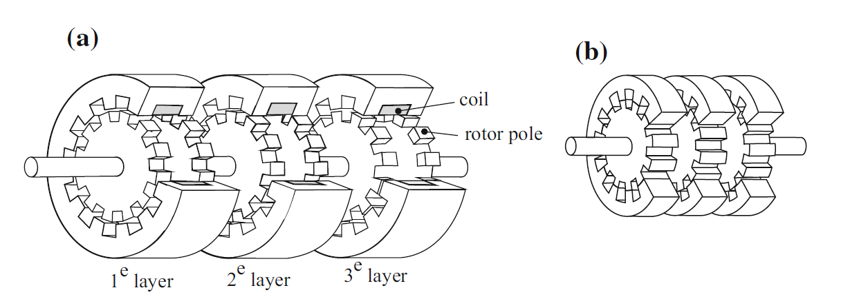
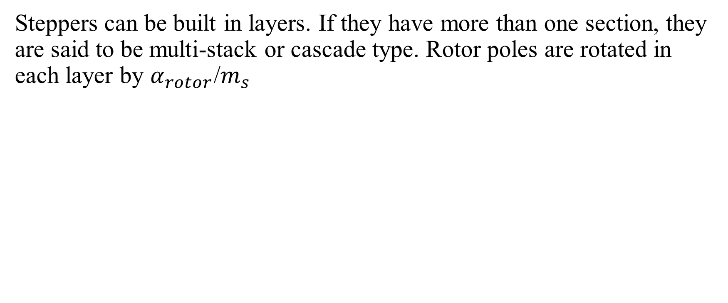
Multi-stack stepping motors
Steppers can be built in layers. If they have more than one section, they are said to be multi-stack or cascade type. Rotor poles are rotated in each layer by $α_{rotor}$/$m_{s}$
Multi-stack VR stepping motor: a homopolar, b heteropolar

Slide 10
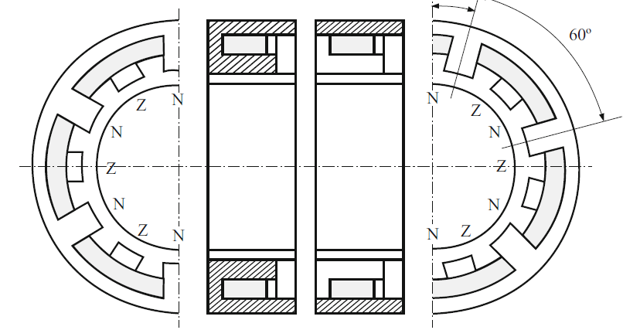
Permanent magnet steppers
Motor has a magnetized rotor. The magnetization in alternating NSNSNS around the rotor. Multi-stack steppers with PM are available. In this case rotor’s poles are not rotated in each layer but rather the poles in the stator.

Slide 11
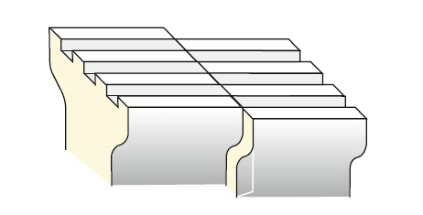
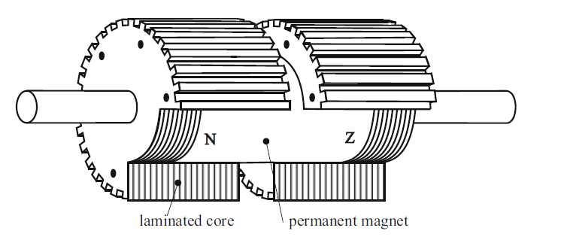
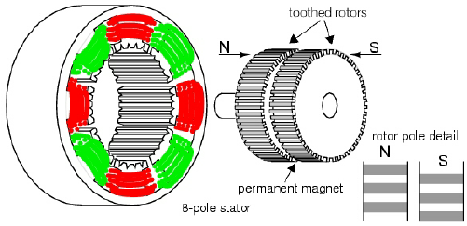
Hybrid stepper motors
Hybrid stepping motors combine the torque effect of reluctance and permanent magnets. The rotor contains 2 toothed sections displaced by half tooth pitch. Axial permanent magnets are placed inside the rotor.
Stator construction remains the same, but the windings and connections are different: 2 coils on each pole are assigned to distinct phases. Invese variations are possible.

Slide 12
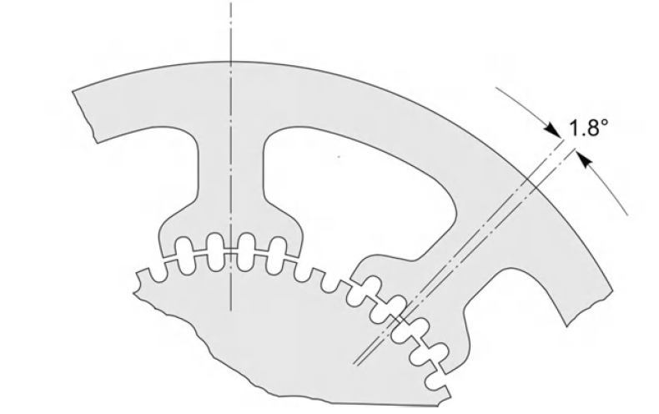
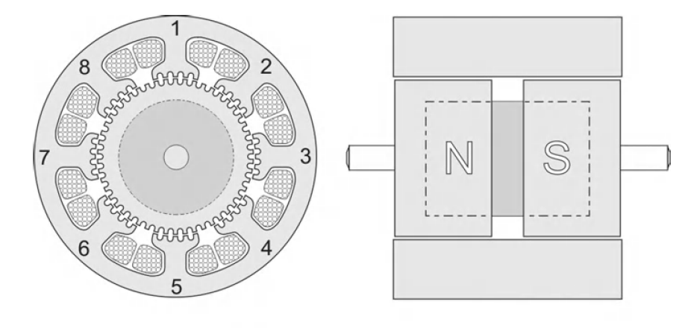
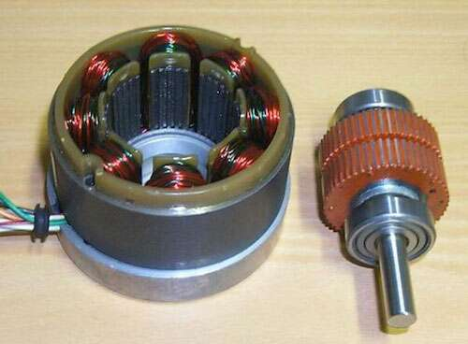
A- 1,3,5,7
B-2,4,6,8

Slide 13
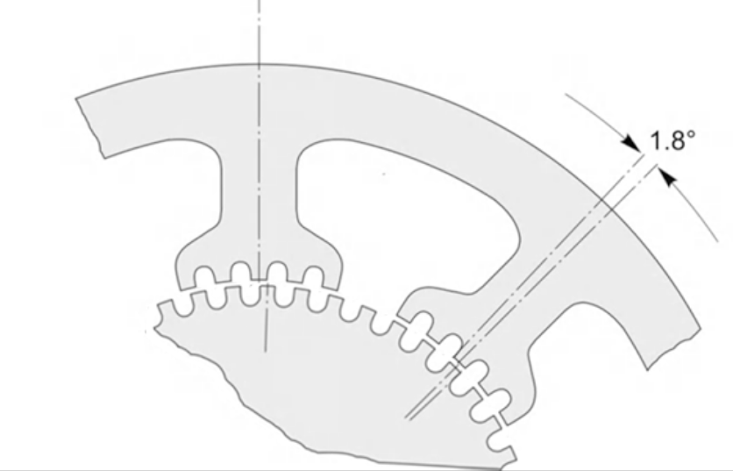
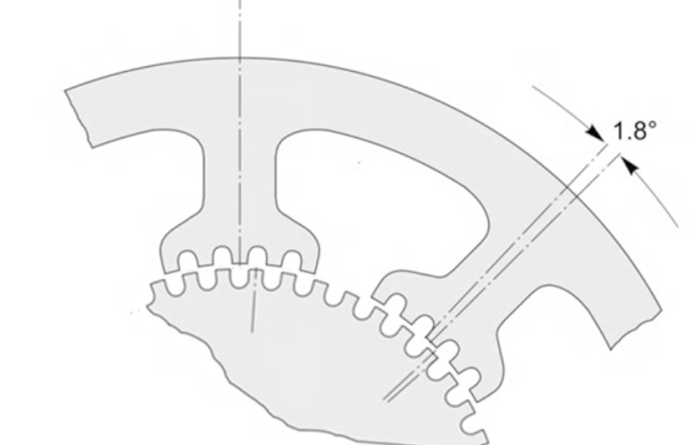
The motor is continuously stepped by energizing the phases in the sequence A, -B, -A, B, A (anticlockwise) or A, B, -A, -B, +A (clockwise). A bipolar supply is needed (i.e. one which can produce -V or V current). When the motor is operated in this way it is referred to as ‘2-phase, with bipolar supply‘
+A
-A
B

Slide 14
Mechatronic Equipment: Sensors for mechatronic systems
Vilius Vertelis
vilius.vertelis@vilniustech.lt
2021

Slide 15
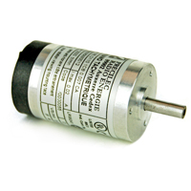
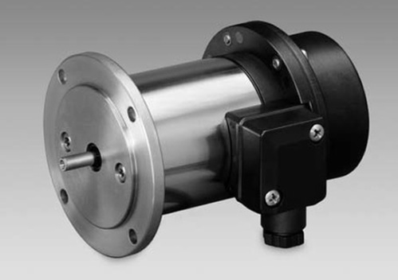
Tachogenerator
A tachometer generator is an electrical generator for recording the speed of electrical and other rotating machines, such as speed-controlled drives or engine test benches . Tacho generators were very common as speed sensors, but are increasingly being replaced by cheaper incremental encoders that can work to a standstill.

Slide 16
Tachogenerators are used:
To measure rotation speed. When connected to a voltage reader it becomes a tachometer.
In automation and control for feedback about motors rotation speed
To reduce vibrations of servo motors

Slide 17
Techogenerators: requirements
Linear and stable EMF vs. rot. Speed characteristic
Minimal “Dead” zone
Large transfer coefficient
Symmetric voltage for both directions of rotation
Low voltage ripple
Low moment of inertia, mass, size and size

Slide 18
DC tachogenertor
DC tachogenerator is a machine that is nearly identical to a DC generator. The magnetic flux can be created either by permanent magnets or by an excitation winding.
Most tachogenerators used today are brushed DC types with a permanent magnet stator and a wound, rotating armature. One end of the armature is attached to the object whose speed is being measured, and the armature rotates within the magnetic field of the stator. As the measured object rotates, the rotation of the tachogenerator armature induces a voltage, and the amplitude of the voltage is proportional to the speed of rotation. A commutator converts the alternating current generated by rotation into direct current that can be interpreted by a voltmeter circuit and converted to speed. If the direction of rotation changes, the voltage polarity changes, so DC tachogenerators can determine both speed and direction of rotation.

Slide 19
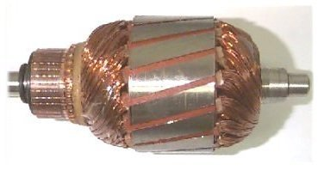
DC tachogenertor construction.
Reminder: DC generator can have 2 types of windings: armature and excitation. DC tachos can also have these windings. Excitation winding can be replace by permanent magnets.
The armature windings are skewed to minimize the ripple in EMF.
Magnetic guide is made from sheets of electrotechnical steel.
Large number of collector plates
Specialized brushes.

Slide 20
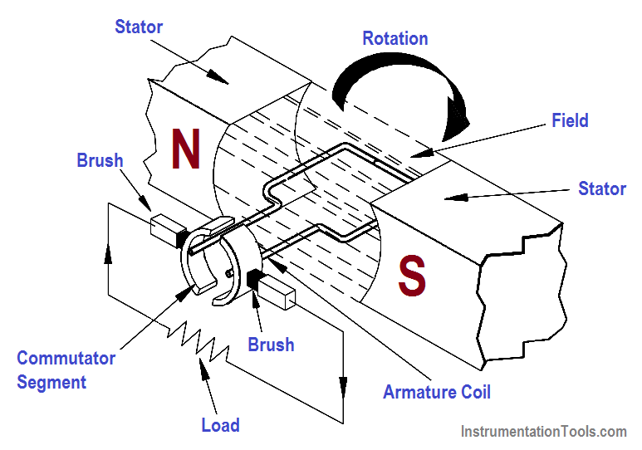
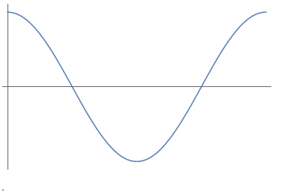
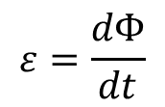
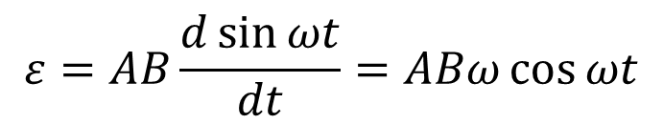
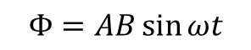
How to make electricity from motion?
$$ε=\frac{dΦ}{dt}$$
$$Φ=AB\sin{ωt}$$
$$ε=AB\frac{d\sin{ωt}}{dt}=ABω\cos{ωt}$$

Slide 21
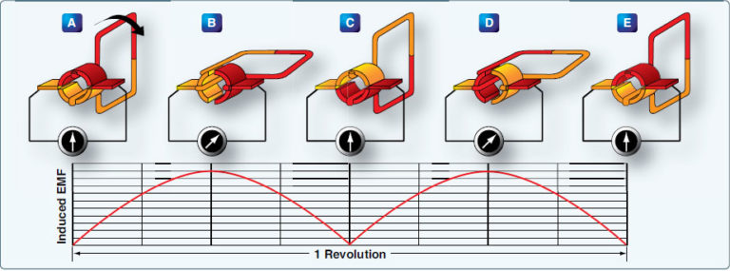
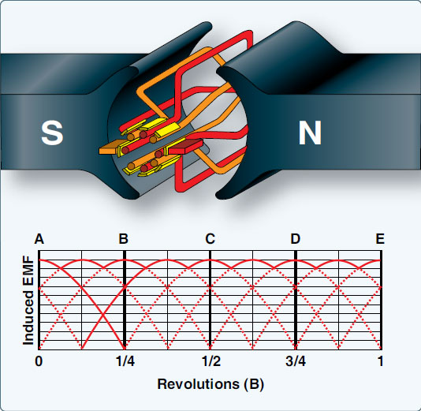
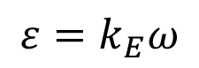
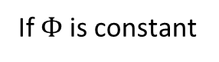
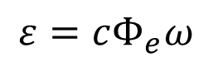
Commutator/Collector
If $Φ$ is constant
$$ε=cΦ_{e}ω$$
$$ε=k_{E}ω$$
EMF is proportional to the speed of rotation

Slide 22
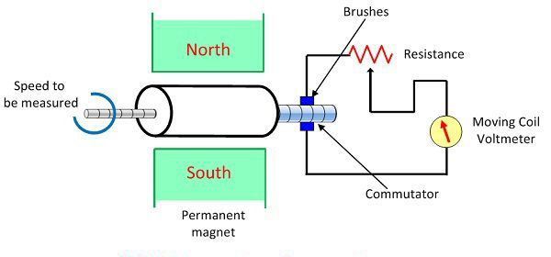
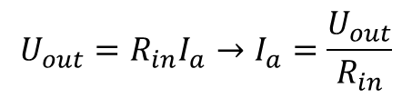
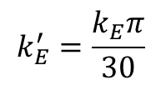
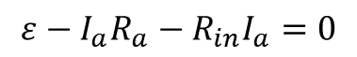








Working principle
Tacho generator is connected to a measuring device that has a certain input resistance $R_{in}$.
$$R_{a}$$
$$ε↑$$
$$R_{in}$$
$$ε−I_{a}R_{a}−R_{in}I_{a}=0$$
$$U_{out}=R_{in}I_{a}→I_{a}=\frac{U_{out}}{R_{in}}$$
$$k_{E}ω−\frac{U_{out}}{R_{in}}R_{a}−U_{out}=0$$
$$k_{E}^{′}=\frac{k_{E}π}{30}$$
$$ε=k_{E}ω$$
$$U_{out}=\frac{k_{E}}{\frac{R_{a}}{R_{in}}+1} ω$$
$$U_{out}=\frac{k_{E}′}{\frac{R_{a}}{R_{in}}+1} n$$
or

Slide 23





$$U_{out}=\frac{k_{E}}{\frac{R_{a}}{R_{in}}+1} ω$$
When values of R are constant, this equation is linear and cross the origin (0,0 point)
$k_{BR}=\frac{k_{E}}{\frac{R_{a}}{R_{in}}+1}$ is the ratio between rot. speed and output voltage and is called the transfer coefficient.
R1>R2
$$U_{out}$$
R2>R3
R3
$$n$$

Slide 24

Transfer coefficient
In the spec. sheet, tr. koef. can be given in different ways.
One way is to give voltage at a certain rpm with a given $R_{in}$.
E.g. 20V at 1000 rpm with 2.2 $kΩ$. Dividing one by the other $k_{BE}=20\frac{mV}{rpm}$
Some manufacturers give nominal voltage and armature current at given rpm.
E.g. 10V 10mA at 1000 rpm. $k_{BE}=10\frac{mV}{rpm}$ and $R=10 kΩ$

Slide 25

Non ideal tacho
So far we assumed constant R and $Φ$. In real tachos this is not necessarily true.
R can change due to transitional resistance of the brushes and $Φ$ due to armature reaction.

Slide 26


Reminder: Armature reaction
Armature windings produce MF.
Armature field is perpendicular to the pole field.
Total MF is the superposition of pole and armature fields
$$B_{tot}=B_{pole}+B_{arm}$$
The total field will be higher in places where $B_{pole}$ is in the same direction as $B_{arm}$ and lower where they are opposite.
If the magnetic circuit is far from saturation, than armature reaction has little effect.
If the core is near saturation, the increase of field will lead to a small increase of B while a decrease will reduce B substantially. This will cause a net reduction of magnetic flux in the machine.

Slide 27





Real tachogenerator
Let’s say there is a constant voltage drop $ΔU$ between the brushes and the collector and $Φ=Φ_{s}−Φ_{r}$.
$$Φ_{r}=k_{r}I_{a}, I_{a}=\frac{U_{out}}{R_{in}}$$
$$cΦω−R_{in}I_{a}−ΔU−U_{out}=0$$
$$cΦ_{s}ω−k_{r}I_{a}ω−R_{in}I_{a}−ΔU−U_{out}=0$$
$$k_{BE}ω−k_{r}\frac{U_{out}}{R_{in}}ω−R_{in}\frac{U_{out}}{R_{in}}−ΔU−U_{out}=0$$
$$U_{out}=\frac{k_{BE}ω−ΔU}{\frac{k_{r}}{R_{in}}ω+\frac{R_{in}}{R_{in}}+1}$$
$$U_{out}$$
With voltage drop
Ideal
With voltage drop and armature reaction
Dead zone
$$n$$

Slide 28
ERRORS: sources
Load resistance
Linearity error
Calibration error
Brush contact resistance
Armature reaction
Output voltage asymmetry
Thermal drift

Slide 29







Errors: Load resistance
If R is incorrect, than there will be an error in the interpretation of a reading.
R1>R2
$$U_{out}$$
R2>R3
Imagine we measure $U$ and get a value of $U_{m}$.
We think that resistance is equal to R2, so we deduce that n=n2.
If, however, R is not R2, the true n value is not n2. We get an error in our reading.
R3
$$U_{m}$$
$$n$$
$$n1$$
$$n2$$
$$n3$$

Slide 30






Linearity error
$$U_{out}$$
$$U_{t}$$
$$U_{f}$$
The U(n) curve is linear in the low speed region.
At high speeds, it can deviate from a straight line due to armature reaction, skin effect, hysteresis loss, increasing brush contact resistance and other factors attributed to high speed.
This deviation in quantified as:
$$\frac{U_{f}−U_{t}}{U_{t}}100\%$$
$U_{f}$ is the measured value, $U_{t}$ is the voltage on a linear curve at that rot. speed.
$$n$$

Slide 31
Calibration error
Permanent magnets used in DC tachos are specially aged, so that their properties become stable (flux does not change in time). Despite that, flux of the PM still changes slowly over years. This changing flux causes a change in the transfer constant. This is called the calibration error and can be eliminated by calibrating the device one more.

Slide 32

Brush contact resistance
Voltage drop between the brushes and the collector causes the dead sensitivity zone near n=0. This limits its applications for low speed measurements.
Lowest measureable rot. speed is $n_{min}=\frac{ΔU}{k_{BE}}$
This is a big drawback and $n_{min}$ needs to be as low as possible. Special copper/graphite or silver/graphite brushes are used. For very precise Tachos, goltplated silver wire brushes are used.

Slide 33
Armature reaction
$$U_{out}$$
$$U_{t}$$
$$U_{f}$$
Due to the armature reaction, U(n) deviates
from a straight line. This causes an between the actual rotation speed and the one estimated assuming that the characteristic is straight.
Several ways to limit this:
Air gap is increased to operate device in a linear region of B(H)
Increasing H so that the core saturates, which, again, is a linear region of B(H).
$$n$$

Slide 34

Output voltage asymmetry
Nonsymmetrical output voltage (U(n)$≠−$U(-n)) is caused by brush location. If the brushes are positioned not perpendicular to magnetic neutral axis, current in the armature creates flux that has a component parallel to the stator’s flux. When tacho is turning one way, this flux can increase the flux in the machine and decrease it when rotating in the opposite direction. This causes the positive and negative branches of U(n) to be different.
$$2\frac{|U\left(n\right)|−|U\left(−n\right)|}{|U\left(n\right)|+|U\left(−n\right)|}⋅100\%$$

Slide 35
Thermal drift
Thermal drift happens due to Joule heating of the excitation winding. This changes the resistance and in trun the magnetic flux, EMF and output voltage.
This can be limited by using a thermorezistor with negative thermal coefficient. Its resistance decreases with temperature and this counters the increasing resistance of the winding. Other way is to add a much larger resistor to make the change low in comparison.
Another way is to use magnetoelectric excitation.

Slide 36
Collector and brushes
Accuracy of a DC tach depends on collector/brush node.
Classic copper collector and carbon brush combination is not reliable due to uneven resistance of copper oxide layer that forms on top.
Copper collector and silver/graphite brushes are better as the layer that forms is conductive. However, if oil, acid, salt or water is present, this layer can disappear. Metal containing brushes degrade faster and need to be replaced.
Silver tracks can be used in the collector to improve the performace of the brushes even in hard conditions.

Slide 37
Main parameters
Rated voltage
No-load voltage
Rated current
Load resistance
Max. rotation speed
Armature resistance
Armature inductance
Polarity
Number of poles
Admissible shaft load
Ripple frequency
Asymmetry error
Linearity error
Thermal drift
Moment of interia

Slide 38






Measuring acceleration
DC tach can be used to measure acceleration. To do so, an analog differentiator circuit can be connected to the output.
When speed is constant no current is flowing as $U_{c}=ε$
$$I=\frac{dQ}{dt}, Q=CU, I=C\frac{dU_{in}}{dt}$$
a
$$U_{out}$$
In our case
$$U_{in}=ε=k_{E}ω$$
$$U_{out}=RI=RC\frac{dU_{in}}{dt}=RCk_{E}\frac{dω}{dt}$$

Slide 39

AC tachogenerator
AC tachogenerator is an AC machine whose output is proportional to its rotation speed.
The DC tachometer generator uses the commutator and brushes which have many disadvantages. The AC tachometer is very similar to a synchronous generator. Stationary armature usually has 3 phases while the rotor is a permanent magnet.
Rotating field induces EMF that is offset by 120$°$. Its amplitude and frequency depends on the rotation speed.

Slide 40





The output of AC tach can be rectified to a DC with a ripple of ~5%

Slide 41


Asynchronous tachogenerator: drag-cup tach
Construction is the same as asynchronous motor with the exception that the rotor is hollow and nonmagnetic. A “drag-cup” rotor is used.
It is a hollow cylinder made out of conductive non magnetic material (copper, aluminum, etc.)
Stator has 2 windings offset by 90$°$.
1 is connected to a single phase
power supply to excite the magnetic field.
The other is used to measure voltage and is called the output winding.
Usually, AC tachos have 4 poles to minimize inconsistencies of the air gap.

Slide 42



Asynchronous tachogenerator: no rotation
The excitation winding creates a pulsating magnetic field. Electric current is induced at the surface of the conductive rotor. The induced rotor flux is opposite to the pulsating field.
The created flux is 90$°$ off the output coil, so no
EMF is generated inside it.
In practice, there is always a small voltage at n=0.
Angle is not exactly 90$°$
Asymetry of the magnetic circuit
Leakage flux
Capacitive link between coils
Input coil
$$Φ_{ex}$$
+
+
+
$$Φ_{in}$$
+
Output coil
+
+
+

Slide 43



Asynchronous tachogenerator: rotation
When the rotor rotates, currents oppose not just the pulsation but also the rotation of the field. The flux lines are rotated alongside with the rotor. Flux lines are now offset from 90$°$ and emf appears in the output coil. The emf has the frequency of the grid. Amplitude depends of the frequency and the rotation speed.
$$U_{out}=ε−I_{a}Z_{a}$$

Slide 44

Synchos/selsyns
Synchros are machines whose output is proportional to the angle of rotation. Synchros can either transmit or receive voltage or torque imputs. The name originates from self +synchronous. Also known as self synchronous unit, autosyn or magslip.
Simplest synchronous system is made up of 2 identical selsyns.
1 transmitter and 1 receiver.

Slide 45
Functional categories
A synchro will fall into one of eight functional categories.
Torque transmitter (TX)
Input: rotor positioned mechanically or manually by the information to be transmitted.
Output: electrical output from stator identifying the rotor position supplied to a torque receiver, torque differential transmitter or a torque differential receiver.
Control transmitter (CX)
Input: same as TX.
Output: electrical output same as TX but supplied to a control transformer or control differential transmitter.
Torque differential transmitter (TDX)
Input: TX output applied to stator; rotor positioned according to amount data from TX that must be modified.
Output: electrical output from rotor (representing an angle equal to the algebraic sum or difference of rotor position angle and angular data from TX) supplied to torque receivers, another TDX, or a torque differential receiver.
Control differential transmitter (CDX)
Input: same as TDX but data supplied by CX.
Output: same as TDX but supplied to only a control transformer or another CDX.

Slide 46
Functional categories
Torque receiver (TR)
Input: Electrical angle position data from TX or TDX supplied to stator.
Output: Rotor assumes position determined by electrical input supplied.
Torque Differential Receiver (TDR)
Input: electrical data supplied from two TX's, two TDX's or from one TX and one TDX (one connected to the rotor and one connected to the stator).
Output: rotor assumes position equal to the algebraic sum or difference of two angular inputs.
Control transformer (CT)
Input: electrical data from CX or CDX applied to stator. Rotor positioned mechanically or manually.
Output: electrical output from rotor (proportional to sine of the difference between rotor angular position and electrical input angle.
Torque receiver-transmitter (TRX)
This synchro was designed as a torque receiver, but may be used as either a transmitter or receiver.
Input: depending on the application, same as TX.
Output: depending on the application, same as TX or TR.

Slide 47


Construction
Synchros can be either 1 or 3 phased. 3 phase synchros are constructed as 3 phase asynchronous machines with a phase wound rotor. Single phase selsyns are similar to synchronous motors.

Slide 48


Construction
Excitation windings are connect to power grid. These windings are usually in the rotor, but can also be in the stator. Signal windings between 2 synchros are connected via transmission line
1 phase selsyn has 1 excitation winding and 3 signal windings.
3 phase selsyn has at 3 excitation windings and 3 signal windings.
Usually, selsyns have 2 poles to ensure synchronization in one full rotation.

Slide 49

Construction
Brushes limit the reliability of selsyns.
If a limited angle is needed (lets say 60$°$) brushes can be replaced with flexible wire.
If the rotation needs to be continuous, brusheles selsyns are used
for high accuracy operations. Brusheless selsyns use variable reluctance rotor to direct the magnetic flux.

Slide 50

Uses
3 phase selsyns are used as electric shaft, where a synchronous rotation is needed at both ends. For example to move indicators at large distances.
Single phase selsyns are essentially resolvers (later about those).

Slide 51
Uses
There are two types of synchro systems: torque systems and control systems.
In a torque system, a synchro will provide a low-power mechanical output sufficient to position an indicating device, actuate a sensitive switch or move light loads without power amplification. In simpler terms, a torque synchro system is a system in which the transmitted signal does the usable work. In such a system, accuracy on the order of one degree is attainable.

Slide 52
Uses
In a control system, a synchro will provide a voltage for conversion to torque through an amplifier and a servomotor. Control type synchros are used in applications that require large torques or high accuracy such as follow-up links and error detectors in servo, automatic control systems (such as an autopilot system). In simpler terms, a control synchro system is a system in which the transmitted signal controls a source of power which does the usable work.
Quite often, one system will perform both torque and control functions. Individual units are designed for use in either torque or control systems. Some torque units can be used as control units, but control units cannot replace torque units.

Slide 53

Working principle: 1 phase
AC is supplied to the rotor coil. This current creates MF that crosses the signal windings in the stator. Since the angle is different, the induced EMF will have different amplitude in each winding.
Signal windings are connected between 2 selsyns. The EMF in selsyn 1 creates current in each winding with the same ratio as EMF. This current passes to Selsyn 2 and creates a MMF in the same direction as in Selsyn1. The rotor experiences torque if its MF is not aligned with the stator MMF. So the rotor synchronizes its position to 0 torque position. When this happens, both excitation coils are producing opposite EMF’s and no current flows in the transmission line.

Slide 54


Let’s do math
$$\cos{Θ}−\cos{Φ=2\sin\left(\frac{Θ+φ}{2}\right)\sin\left(\frac{Θ−φ}{2}\right)}$$
Now if we say that $α_{D}−α_{r}=θ, we can simplify$
$$Δε_{1}=2ε_{a}\sin\left(\frac{α_{D}−α_{r}}{2}\right)\sin\left(\frac{θ}{2}\right)$$
$$Δε_{2}=2ε_{a}\sin\left(\frac{α_{D}−α_{r}}{2}−\frac{2π}{3}\right)\sin\left(\frac{θ}{2}\right)$$
$$Δε_{3}=2ε_{a}\sin\left(\frac{α_{D}−α_{r}}{2}−\frac{4π}{3}\right)\sin\left(\frac{θ}{2}\right)$$
Currents in the windings are $I_{i}=\frac{Δε_{i}}{Z_{i}}$
If we add $\sum_{i=1,2,3}{I_{i}}=0$
If we take a closer look, we see that no current flows in any phase if $θ=α_{D}−α_{r}=0$. This is the synchronous position.
When excitation coil is aligned with one of the signal coils rms emf will be
$$ε_{a}=4.44 NfΦ$$
Now if there is an angle:
$$ε=ε_{a}\cos{α_{D}}$$
Since the coils are offset by $2π/3$, we get in each transmitter coil :
$$ε_{1t}=ε_{a}\cos{α_{D}}$$
$$ε_{2t}=ε_{a}\cos{(α_{D}−2π/3)}$$
$$ε_{3t}=ε_{a}\cos{(α_{D}−4π/3)}$$
Similarly in the receiver
$$ε_{1r}=ε_{a}\cos{α_{r}}$$
$$ε_{2r}=ε_{a}\cos{(α_{r}−2π/3)}$$
$$ε_{3r}=ε_{a}\cos{(α_{r}−4π/3)}$$
Voltage between the receiver and the transmitter
$$Δε_{1}=ε_{1t}−ε_{1r}=ε_{a}\cos{α_{D}}−ε_{a}\cos{α_{r}}$$
$$Δε_{2}=ε_{2t}−ε_{2r}=ε_{a}\cos{(α_{D}−2π/3)}ε_{a}\cos{(α_{r}−2π/3)}$$
$$Δε_{3}=ε_{3t}−ε_{3r}=ε_{a}\cos{(α_{D}−4π/3)}ε_{a}\cos{(α_{r}−4π/3)}$$

Slide 55



Synchronization torque
Synchronization torque is the torque that acts to synchronize the selsyn.
It can be approximated by a sine of the angle between the synchronous position ant the position of the rotor (same as synchronous motor)
$$M_{s}=M_{smax}\sin{θ}$$
It looks like there are 2 synchronous positions, one at 0 and 180, but
The one on 180 is unstable.

Slide 56


Synchronization torque
Main parameter is “partial synchronization torque”. It is torque produced by when the offset is 1 degree. It can be interpreted as a torque-angle slope at near the synchronization point
$$M\left(1°\right)=M_{d}={\left.\frac{dM}{dθ}\right|}_{θ=0}1°={\left.\frac{dM}{dθ}\right|}_{θ=0}$$
In modern selsyns this torque is ~0.5 Nm$⋅$cm

Slide 57

Errors
Selsyns working in control regime transfer angle with an error. This error is caused by friction in the bearing, brushes, higher harmonics and manufacturing inconsistencies.
Main source of error is due to friction. It causes a dead zone in the sensitivity. It can be quantified as a ratio between the friction torque and partial synchronization torque
$$D=\frac{M_{fr}}{M_{d}}$$
Larger $M_{d}$ means steeper M curve and in turn shorter dead zone.

Slide 58







Errors
$$M_{d2}$$
$$M_{fr}$$
$$M_{d1}$$
$$θ_{1}$$
$$θ_{2}$$
$$θ_{dead}$$

Slide 59

Some facts about operation
Torque in a synchro system is sensitive to the transmission line resistance. Large resistance limits current and in turn the synchronizing torque.
Synchro systems can have large number of elements. Synchronizing torque decreases with every added element as
$$M_{dN}=\frac{2M_{d1}}{1+N}$$
$M_{d1}$- partial synchronization torque of a single element, N- number of elements.

Slide 60

Some facts about operation
Synchronizing torque is produced in the transmitter as well as the receiver. In simple system with a receiver and a transmitter both torques are equal but opposite direction.
Equilibration period – time over which a selsyn stabilizes at the synchronous point after a devioation of 179$°$ offset. In modern selsyns, ~0.5-1.5 s.

Slide 61
Angle transfer accuracy depends on
Partial synchronization torque. It itself depends on supply voltage and frequency, transmission line resistance, number of receivers.
Load on the receiver. Usually due to friction in the bearings and brushes.
Quality of the selsyn- ratio between partial synchronization torque and friction torque.
Magnetic asymmetry. It causes additional forces that can introduce a deviation from synchronization point.
Rotor balance.

Slide 62

Angle transfer accuracy
Accuracy is measured by rotating the transmitter 360$°$ one way and then the other and measuring the error in the receiver every 10$°$. Positive and negative deviations are obtained over whole revolution.
The error of a receiver is quantified by an error $Δθ$
$$Δθ=(θ_{max+}+θ_{max−})/2$$
$θ_{max±}$ is the maximal positive/negative deviation

Slide 63
Angle transfer accuracy
Accuracy is measured by rotating the transmitter 360$°$ one way and then the other and measuring the error in the receiver every 10$°$. Positive and negative deviations are obtained over whole revolution.
The error of a receiver is quantified by an error $Δθ$
$$Δθ=(θ_{max+}+θ_{max−})/2$$
$θ_{max±}$ is the maximal positive/negative deviation

Slide 64


Angle transfer accuracy
Based on $Δθ$ receivers are classified into:
Error of the transmitter is the difference between the rotors position where the synchronizing emf is equal to 0 and its theoretical position. Transmitters are classified into:
Class | I | II | III | IV
$$Δθ, °≤±$$ | 0.5 | 0.75 | 1 | 1.5
Class | I | II | III | IV | V | VI | VII
$$Δθ, °≤±$$ | 1 | 2 | 3 | 5 | 10 | 20 | 30

Slide 65

Dynamic regime
Transmitter can either be stationary at a position or be rotating at a certain speed. Regime where the rotor is rotating is called the dynamic regime.
In the dynamic regime, additional EMF is generated. This EMF creates electrical current that lowers the synchronizing current and synchronizing torque. The negative effect increases with increasing rotation speed.
For low speeds ( up to 20% of synchronous speed f/p) the torque can be calculated
$$M_{din}=M_{stat}\cos\left(\frac{πυ}{2}\right)$$
Here $υ$ is relative rotation speed $n/n_{syn}$

Slide 66

Torque system
Toqrue system is used for physical applications where a considerable torque is needed at the receiver (i.e. rotating a shaft) and the small indicator selsyn is not enough.
Torque transmitter (TX)
Control transformer (CT)
TX is rotated to a position.
CT creates emf prop. to misalignment. This emf feeds into an amplifier that controls a motor. Motor rotates until emf becomes 0.

Slide 67

Torque system
In torque system, the synchronous angle is offset by 90$°$ than in control system. Receiver does not maintain the angle, but only creates emf. Torque is produced by a servo motor.

Slide 68

Torque system quality factors
Remnant voltage – receiver voltage output at synchronous point.
Output voltage at $θ=1°$
Output power $θ=1°$
Electric and magnetic asymmetry
Resistance of the transmission line
Number of receivers connected to a transmitter

Slide 69

Torque system quality factors
Output voltage $U=\frac{2π}{\sqrt{2}}fNΦ$. Output voltage can be increased by increasing the number of windings N or the line frequency f.
Accuracy is determined in the same manner as in the control system.
Receivers are usually of non-salient type to avoid additional reluctance torque.

Slide 70

Differential selsyn
Differential selsyns are used when two angles need to be added or substracted. Their construction is similar to asynchronous motors with phase wound rotors. They can either be a receiver or transmitter and are always used together with 2 other selsyns.

Slide 71
Resolvers
A resolver is a type of rotary electrical transformer used for measuring degrees of rotation. It is considered an analog device, and has digital counterparts such as the digital resolver, rotary (or pulse) encoder. It is an AC machine whose output voltage is proportional to sin or cos to the angle of rotation.

Slide 72


Resolver
A resolver uses the same basic physical principles as an electrical transformer. Resolvers typically use copper windings in its stator and a machined metal rotor. The inductive coupling between the windings varies according to the angular position of the rotor. The resolver is energized with an AC signal and the resulting output from the transformer windings is measured to provide an electrical signal which is proportional to angle.
$$V_{sin}=V_{a}\sin{ωt}\sin{α}$$
$$V_{cos}=V_{a}\sin{ωt}\cos{α}$$
$$\frac{V_{sin}}{V_{cos}}=\tan{α}$$
$$α=\arctan{\frac{V_{sin}}{V_{cos}}}$$

Slide 73




Contactless resolvers.

